Slide 1
IPsOS Uk 2024 election review: initial conclusions
March 2025

Slide 2
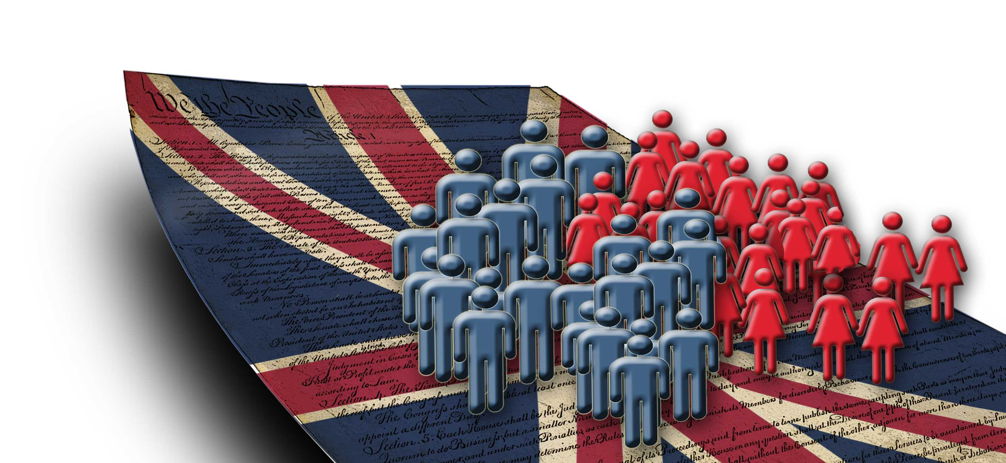
We have been conducting a review into our GE2024 performance
Following the 2024 General Election, Ipsos has been conducting a thorough review into our methods.
This document outlines the initial findings from this review.
Learnings will feed into a new approach to voting intention – which will be revealed in due course.

Slide 3
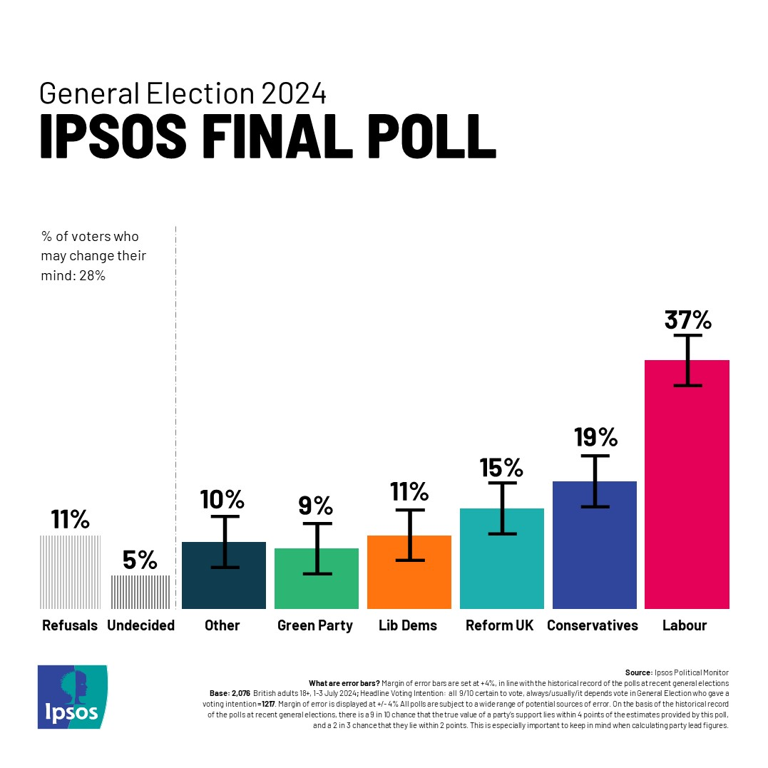
A reminder of our method and our 2024 prediction
CATI methodology – mix of RDD landline / mobile and targeted mobile sample.
Prompt for Labour, Conservative, Lib Dems and SNP / Plaid (if Scot/Wales) but smaller parties unprompted.
Demographic weighting (but no weighting by past vote).
Turnout filter – 9/10 or 10/10 likely to vote and always / usually vote / it depends.
Don’t knows / refused squeezed.
This method was highly successful in 2019 when we called each party correctly, with only one party a single percentage point out.

Slide 4
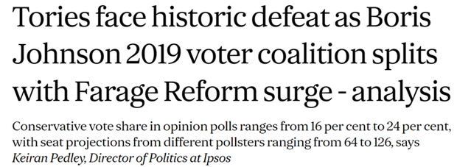
Our final poll told the right story but understated the Conservative share
Our opinion polling and MRP modelling told the correct story of the campaign – a historic Conservative defeat, with Reform gaining ground and Labour losing support last minute. Turnout down and tactical voting up.
We also called Reform UK correctly.
However, our final poll understated the Conservatives by 5 points.
A larger than normal number of refusals was likely a key factor in this.
Prediction poll vs result
Party | Prediction | Result | Difference
Labour | 37% | 35% | +2
Conservative | 19% | 24% | -5
Reform | 15% | 15% | =
Lib Dem | 11% | 13% | -2
Green | 9% | 7% | +2
Other | 10% | 7% | +3

Slide 5
Compared to the wider industry, we overstated Labour less but understated the Conservative share more
Party | Ipsos final poll | Poll average | Result
Labour | 37% | 39% | 35%
Con | 19% | 22% | 24%
Reform UK | 15% | 16% | 15%
Lib Dem | 11% | 11% | 13%
Green | 9% | 7% | 7%
Other | 10% | 6% | 7%

Slide 6
So what happened?
Late swing?
Measurement error?
Coverage error?
Turnout?
Political engagement?
Other approaches better?

Slide 7
Late swing? 15% decided who to vote for in the final hours. This can create volatility in the numbers but cannot completely explain our miss
When did you decide which party/candidate you would vote for?
Before the campaign started
In the first week of the campaign
Around the middle of the campaign
Within the last week of the campaign
Within the last 24 hours of the campaign
Base: 15,206 Online British adults aged 18+ who voted in the 2024 General Election, including 2024 Conservative (3,169), Labour (5,936), Lib Dem (2,297), SNP (650), Green Party (1,046) and Reform UK (1,524) voters, 5-8 July 2024,

Slide 8
A larger number of refusals than usual likely contributed to us understating the Conservative share
% refusals in Ipsos prediction poll
11% of likely voters refused to say who they would vote for – was 4% in 2019
18% of 65+s refused as did 18% of those with no qualifications.
Some form of reallocation of refusals would have helped us be more accurate but we decided not to make a last-minute change to a method that had been successful in 2019.
Clear learning here is to watch refusals – especially where they skew in a certain direction.

Slide 9
If we take our prediction poll and adjust vote shares among those aged 65+ to be ‘correct’ this fixes most of our issues
Comparing our prediction poll to our post hoc ‘How Britain voted’ survey* shows that the cohort aged 65+ was a key miss
We took our prediction poll and adjusted the vote shares for each party for the over 65 cohort so that they matched our ‘How Britain voted’ post hoc poll.
This exercise got us much closer to the final result. Although we would still have understated the Conservatives by 2 points.
This reinforces the sense that the 65+ cohort – where refusals were especially high – was a driving factor in our miss.
 | Prediction poll |  | Reweighted 65+ |  | Result
Con | 19% |  | 22% |  | 24%
Lab | 37% |  | 35% |  | 35%
Lib Dem | 11% |  | 11% |  | 13%
SNP | 6% |  | 6% |  | 3%
Plaid | 1% |  | 1% |  | 1%
Green | 9% |  | 8% |  | 7%
Reform | 15% |  | 15% |  | 15%
Other | 3% |  | 3% |  | 3%
* After every General Election, Ipsos runs a large-scale post hoc survey, weighted regionally to the correct result, to show how different groups voted. The biggest gap with our prediction poll was with those aged 65+. How Britain Voted: 17,394 interviews were carried out with British adults aged 18+, between 5-8 July 2024

Slide 10
Past vote weighting would not have helped much
Ipsos do not weight by past vote. A reasonable question would be whether this makes us less accurate.
However, whilst weighting our prediction poll to past vote helps improve the Labour share a little, it does not fix fundamental issue of our low Conservative share.
So whilst we would never 100% rule out using past vote weighting in the future, it appears clear that not using it here was not a driving factor in any miss.
 | Ipsos final |  | Past vote GE19 / EU16 |  | Result
Con | 19% |  | 19% |  | 24%
Lab | 37% |  | 34% |  | 35%
Lib Dem | 11% |  | 13% |  | 13%
SNP | 6% |  | 5% |  | 3%
Plaid | 1% |  | 1% |  | 1%
Green | 9% |  | 8% |  | 7%
Reform UK | 15% |  | 17% |  | 15%
Other | 3% |  | 4% |  | 3%

Slide 11
But a closer look at sample, turnout and political engagement needed
Seat type
We understated the Conservatives and overstated Labour most in Conservative seats – although there are much fewer of these than seats Labour won.
Turnout
Implied turnout in our prediction poll was consistent across seat type whereas turnout was actually lower in seats Labour won – unclear if this is coverage or measurement issue. We will revisit how we measure turnout in any future method.
Political engagement
Weighting our prediction poll by interest in politics (to BES data) made no difference but we still think overly engaged samples are a challenge to mitigate in future. We are experimenting with different solutions.

Slide 12
Summing up…
Our research told the right story of the election. A historic defeat for the Conservatives amidst growth of Reform UK, with a late swing against Labour and reduced turnout / increased tactical voting.
However, we clearly understated the Conservatives in our final poll. Plus the overall performance of the UK polling industry was worse than in recent elections.
No silver bullet to explain the miss. A range of issues are evident but an unusually high number of refusals likely contributed to a decisive miss with the 65+ cohort. We must also consider the possible impact of over engaged samples and differential turnout as contributing factors.
Looking forward. We are open minded and looking at new methods. Any new approach will give careful consideration as to the appropriate weighting scheme to use, how to manage turnout and what to do about the allocation of refusals / don’t knows. Such considerations – and any method change – will be clearly laid out at the appropriate time.

